Slide 1

Installing Windows 10 And Creating A Bootable USB For Windows 10
Presented By: Zeshan Ali
Google Certified Data Analyst
CTO D Explore X

Slide 2
Today’s Discussion
What is Windows (Operating System).
How To Make A Bootable USB For Installing Windows.
Learning About The Partitioning Formats.
Installing Windows 10.
Learning The Universal Method For Installing Drivers For Every Computer.
How To Create A User Profile After Installing Windows.

Slide 3
What is Windows (Operating System).
When referring to an operating system, Windows or win is an operating environment created by Microsoft that provides an interface, known as a Graphical User Interface (GUI), for computers. Windows eliminates the need to memorize commands for the command line (MS-DOS) by using a mouse to navigate through menus, dialog boxes, buttons, tabs, and icons. If you are using a PC (IBM) computer you are most likely using a version of Windows. If you are on an Apple computer you are using mac-OS.

Slide 4
How To Make A Bootable USB For Installing Windows.
You need a USB Drive with the minimum space of 8GB.
Software we are using is “RUFUS”.
An ISO Of Windows 10 or any other version of Windows it’s up to you.
Your USB must be formatted in NTFS Format.
If You Have All The Items And Software’s then you are good to go.

Slide 5
Learning About The Partitioning Formats. (GPT)
GPT stands for GUID Partition Table. GPT allows for a nearly unlimited amount of partitions, and the limit here will be your operating system. Windows allows up to 128 partitions on a GPT drive, and you don't have to create an extended partition.
GPT brings with it many advantages, but MBR is still the most compatible and is still necessary in some cases. This isn’t a Windows-only standard — Mac OS X, Linux, and other operating systems can also use GPT.

Slide 6
Learning About The Partitioning Formats. (MBR)
MBR standards for Master Boot Record. It was introduced with IBM PC DOS 2.0 in 1983. It’s called Master Boot Record because the MBR is a special boot sector located at the beginning of a drive.
MBR works with disks up to 2 TB in size, but it can’t handle disks with more than 2 TB of space. MBR also only supports up to four primary partitions — if you want more, you have to make one of your primary partitions an “extended partition” and create logical partitions inside it. This is a silly little hack and shouldn’t be necessary.
MBR became the industry standard everyone used for partitioning and booting from disks. Developers have been piling on hacks like extended partitions ever since.

Slide 7
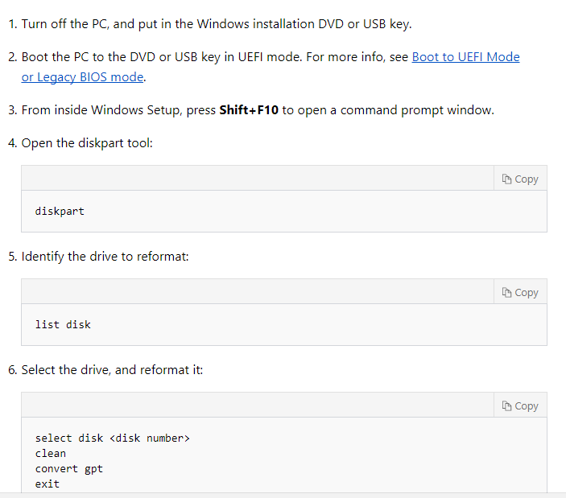
DISKPART IF NEEDED.

Slide 8
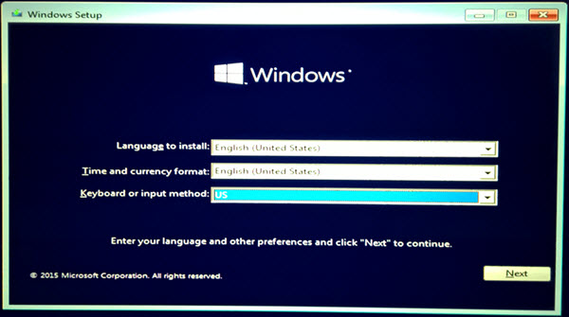
Installing Windows 10.

Slide 9
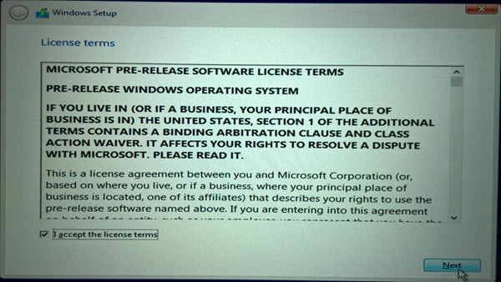
Installing Windows 10.

Slide 10
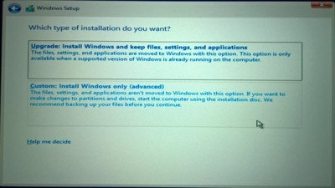
Installing Windows 10.

Slide 11
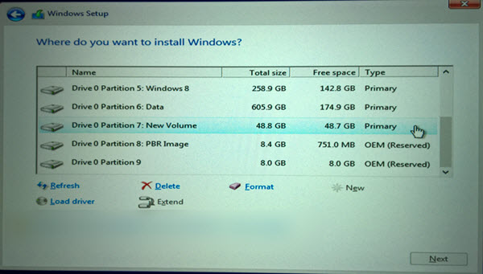
Installing Windows 10.

Slide 12
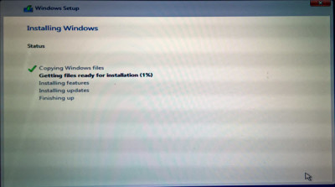
Installing Windows 10.

Slide 13
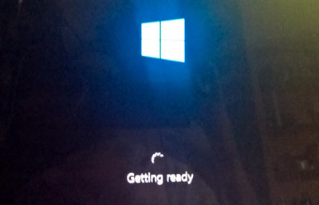
Installing Windows 10.

Slide 14
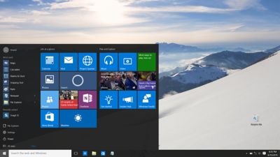
Installing Windows 10.
Windows 10 will ask you a few basic questions about your preferences, before completing the installation and taking you to the Windows 10 desktop.

Slide 15
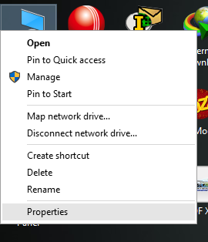
Learning The Universal Method For Installing Drivers For Every Computer.

Slide 16
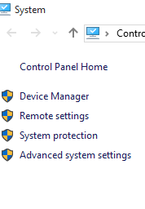
Learning The Universal Method For Installing Drivers For Every Computer.

Slide 17
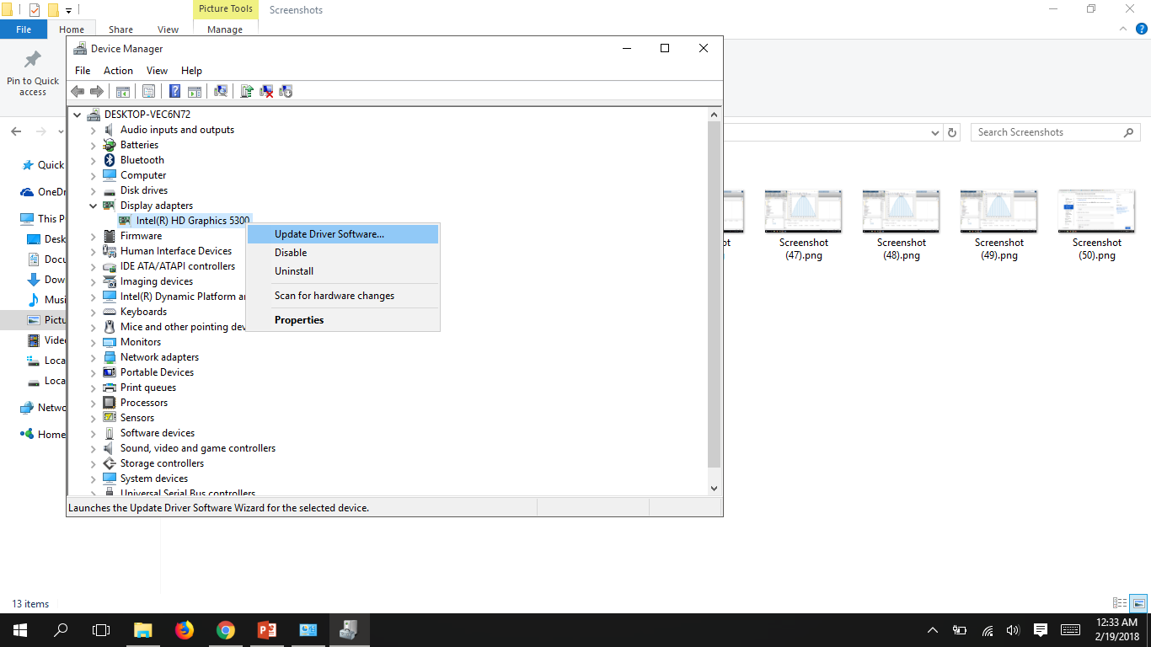
Learning The Universal Method For Installing Drivers For Every Computer.

Slide 18
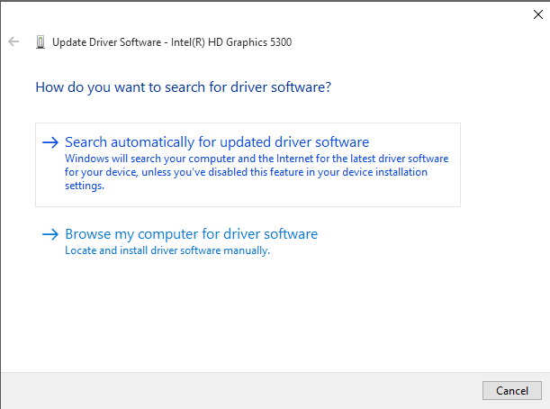
Learning The Universal Method For Installing Drivers For Every Computer.

Slide 19
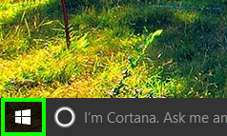
How To Create A User Profile After Installing Windows.
Tap the Windows icon.

Slide 20
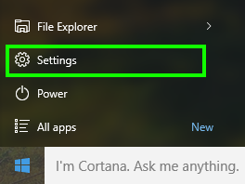
How To Create A User Profile After Installing Windows.
Select Settings.

Slide 21
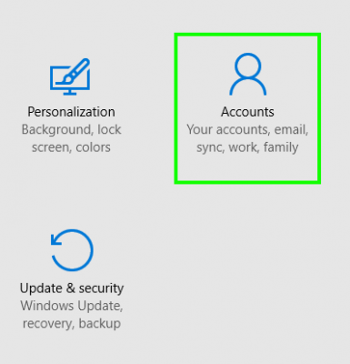
How To Create A User Profile After Installing Windows.
Tap Accounts.

Slide 22
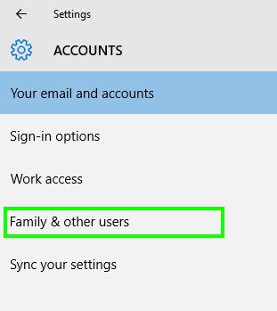
How To Create A User Profile After Installing Windows.
Select Family & other users.

Slide 23
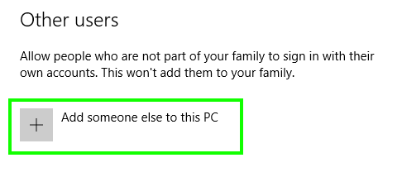
How To Create A User Profile After Installing Windows.
Tap "Add someone else to this PC."

Slide 24
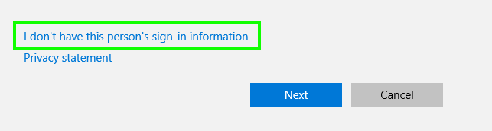
How To Create A User Profile After Installing Windows.
Select "I don't have this person's sign-in information."

Slide 25
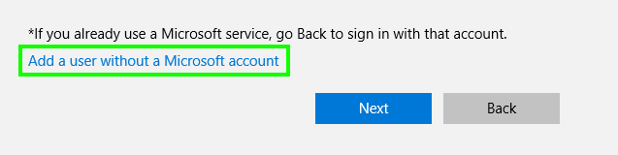
How To Create A User Profile After Installing Windows.
Select "Add a user without a Microsoft account."

Slide 26
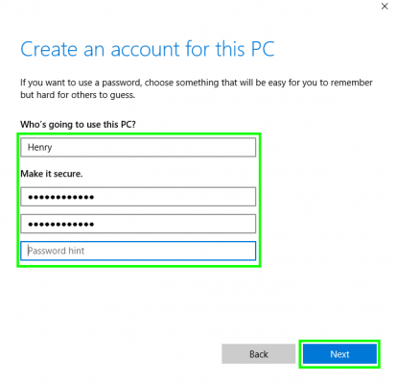
How To Create A User Profile After Installing Windows.
Enter a username, type the account's password twice, enter a clue and select Next.

Slide 27
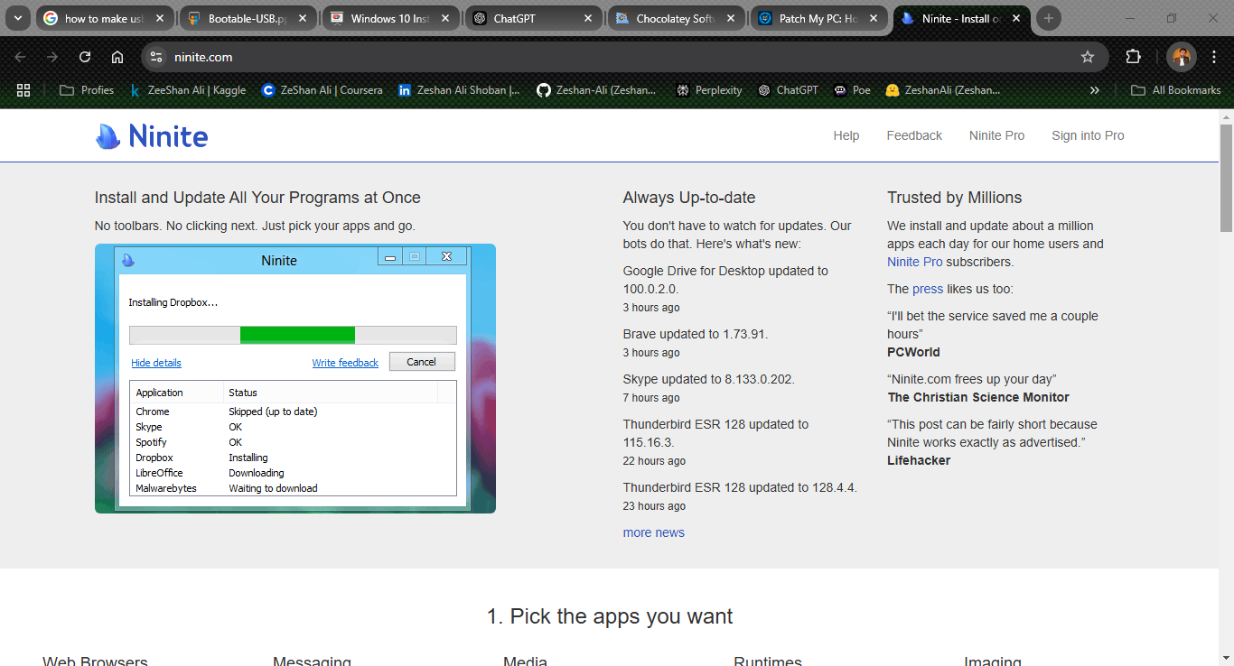
Site that give facility to install softwares with ease
https://ninite.com/

Slide 28
THANK YOU SO MUCH EVERYONE FOR YOUR PRECIOUS TIME ALLAH HAFIZ.

